Slide 1
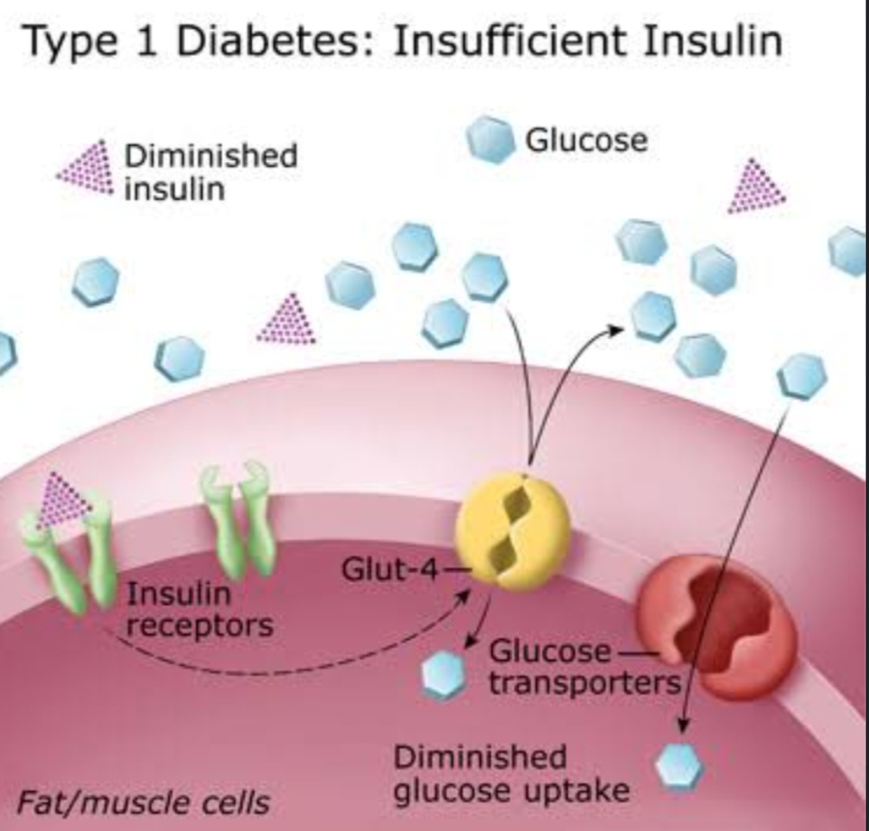
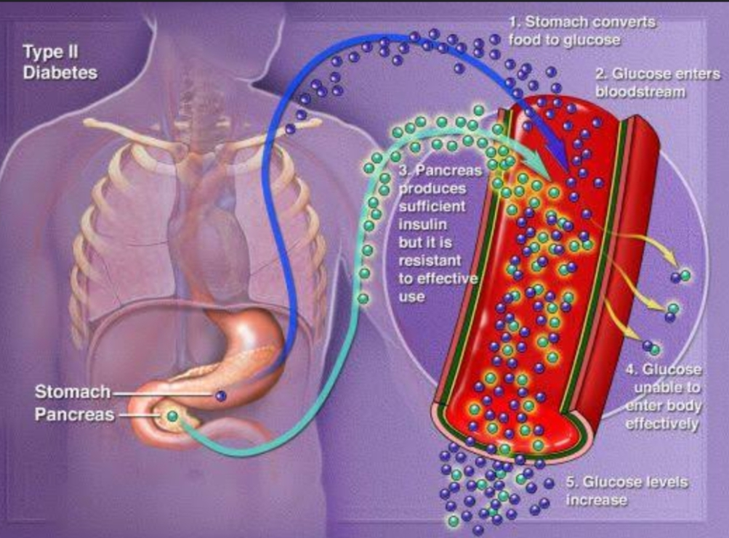
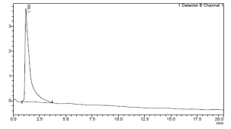
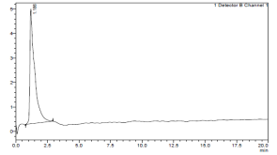
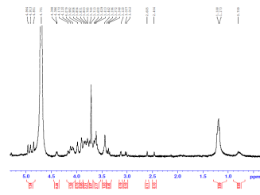
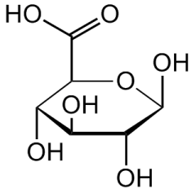
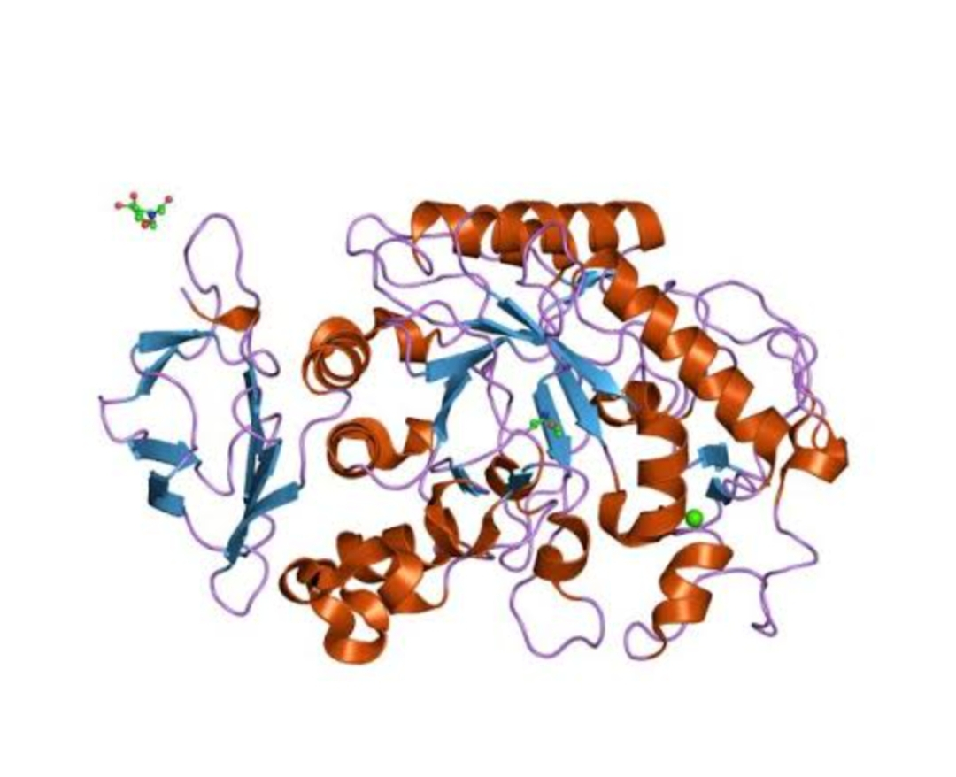
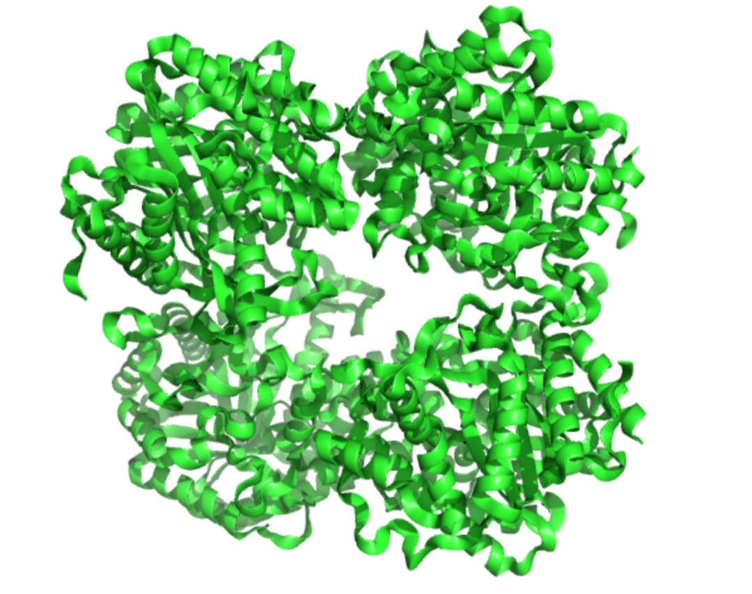
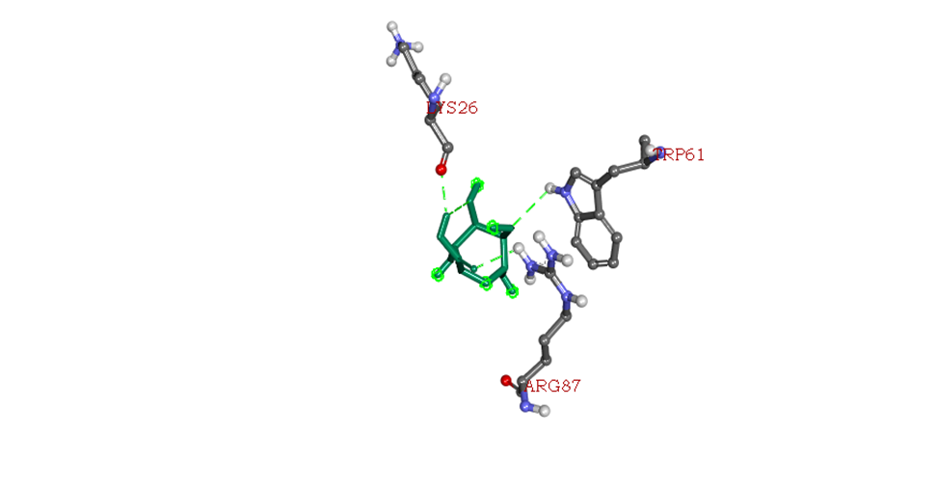
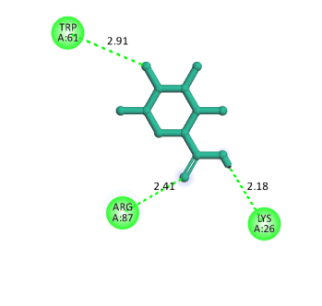
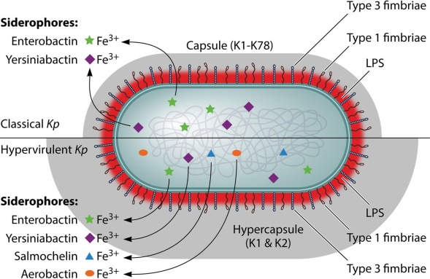
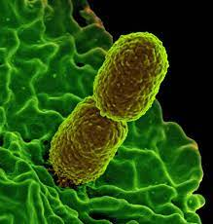
Anti-diabetic potential of bacterial extracellular polysaccharides sugar derivatives derived from Klebsiella pnemoniae By Sridharani. K Sona college of arts and science, salem-05
Abstract
Diabetes is a chronic metabolic disorder characterized by raised glucose levels in the blood, which leads to damage over time to various body organs, including the nerves, heart, kidneys, eyes, and blood vessels. One of its therapeutic treatment approaches involves the inhibition of enzymes accountable for carbohydrate digestion and absorption. There is variety of natural and synthetic compounds explored for the inhibition of α-Amylase and ß-Glucosidase enzyme activities. Bacterial polysaccharides are being a hub of many sugar derivatives. In this present study the poly-glucuronic acid was produced by a high yielding extracellular polysaccharide producing Klebsiella pneumoniae bacterial strain. The produced extracellular polysaccharides were digested into sugar monomers and characterized by FTIR, NMR and HPLC analyses. The C=O and C ̶ O ̶ C functional groups expressed in FTIR spectrum with the corresponding wavenumbers 1630 cm -1 and 1040 cm -1 and the ̶ CH protons of ̶ C2 and ̶ C3 in of sugar ring at 3.7 ppm expressed by NMR and retention time of 1.186 mins corresponding to the glucuronic acid standard all conformed that the polysaccharide was made up of glucuronic acid monomers. Further the α-Amylase and ß-Glucosidase inhibition efficiency of the digested glucuronic acid monomers were investigated in both in silico and in vitro models. The in vitro anti-diabetic assay revealed that the glucuronic acid has good α- Glucosidase inhibition properties. The in silico as well showed good ß-glucosidase inhibition activity with free energy of (-6.2 kcal/mol). These results indicated that the bacterial extracellular polysaccharide sugar derivatives are of potential candidates for the diabetic treatments. Hence it needs further detailed in vivo studies to confirm the therapeutic potential of the compound.
Key words: Diabetic, Glucuronate, α-Amylase, ß-Glucosidase, Bacteria
Introduction :
a disease in which the body’s ability to produce or respond to the hormone insulin is impaired, resulting in abnormal metabolism of carbohydrates and elevated levels of glucose in the blood.
There are two types :TYPE 1 and TYPE 2 Diabetics mellitus
TYPEs
Mechanism:
Alpha amylase hydrolyses starch to glucose
Beta glucosidase converts cellulose to glucose
By inhibiting alpha amylase and beta glucosidase indicates its potential as an antidiabetics treatment. This helps to control the blood sugar level.
Drugs for diabetics:
Sulfonulureas:
Side effects:Hypoglycemia,Hyponatrimia
Biguanides:Eg:phenoformin,metformin(used in
combination theraphy)
Alpha glucosidase inhibitors: eg:Acarbose,miglitol
Anti-diabetic agent from bacteria:
Extra cellular polysaccharide sugar produced from klebsiella pnemoniae is used as anti-diabetic agent (PolyGlucuronic acid)
Materials and Methods:
The EPS producing Klebsiella pneumoniae bacteria was isolated from wastewater by using Kaolin absorption method (Liu et al., 2016)
The isolated strain was Grown in LB Medium for 48 hours. Then cells were removed by centrifugation and EPS was precipitated by ice-cold ethanol. After dialysis the EPS was freeze dried.
The crude EPS was digested with 1 M TFA and its composition was analysed by HPLC with standard sugars.
The functional groups and structure were identified by FTIR and ¹H NMR analyses.
The in vitro α-amylase inhibition, ß-Glucosidase inhibition assays were carried out with commercial enzymes and their respective substrates.
The in silico ß Glucosidase activity was performed by docking ß-glucosidase (PDB ID 7F1N) enzyme with D-Glucuronic acid collected from pubchem database.
It is an auto immune reaction
It destroys the beta cells of pancrease which produce insulin
Type1
Diabetics
Type2
cells do not respond normally to insulin which is called as Insulin resistance.
Prediabetics
Result and discussion:
Sample
Standard
HPLC Chromatograms
FTIR Spectrum
¹H NMR Spectrum
D-Glucuronate Structure
Characterization
α-amylase
ß-glucosidase
In vitro Enzyme inhibition assay
3D model
2D model
In silico Interaction bet ween D-glucuronate and ß-glucosidase
Both glucuronate standard and sample expressed similar retention time in HPLC chromatogram
The Proton NMR spectrum and FTIR Spectrum showed similar molecular features relevant to D-Glucuronate.
These results indicated that the K. pneumoniae EPS was made up of D-Glucuronate monomers
The In vitro α-amylase and ß-glucosidase inhibition assays showed IC₅₀ values of 1.08mg and 0.76mg respectively.
The D-glucuronate showed better inhibition activity for ß-glucosidase then α-amylase
Hence the ß-glucosidase was for taken for molecular simulation studies (in silico)
The in silico molecular simulation studies showed the D-Glucuronate has better binding affinity with ß-glucosidase enzyme with free energy of -6.2 kcal/mol.
These results showed that the bacterial polysaccharide derived Glucuronate is a potential candidate for antidiabetic therapeutic studies.
Klebsiella pneumoniae is a gram negative,encapsulated ,nonmotile bacteria found in environment.
This can be isolated by 16s Rrna gene sequencing method
Quadrant streaking method is performed several times to produce pure bacterial strain

